Slide 1
Network Science
CS 499/CS 599
Spring 2020
Morgan Vigil-Hayes

Slide 2
Review Quiz05

Slide 3
iClicker Question
What is a scale-free network?
(A) Has an exponential distribution of k | (D) A network many short paths between node pairs
(B) Has a power law distribution of k | (E) A network where <C_{i}> = 1
(C) Does not scale computationally

Slide 4
iClicker Question
Which network below represents a scale-free network?
A
B

Slide 5
iClicker Question
Which distribution below represents a scale-free network?
A. Purple
B. Green

Slide 6
Review of Random Graph Models SO Far…

Slide 7
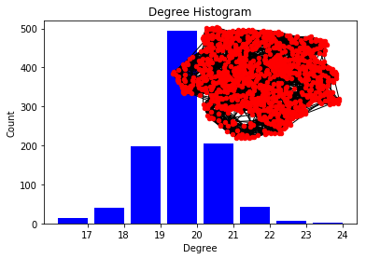
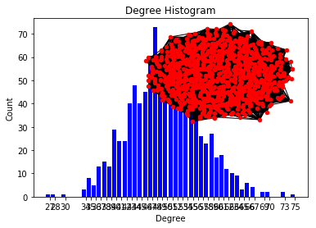
ER and WS models not scale-free
WS
ER

Slide 8
BA model: Growth
BA MODEL: Growth
ER model:
the number of nodes, N, is fixed (static models)
networks expand through the addition of new nodes
Barabási & Albert, Science 286, 509 (1999)

Slide 9
BA model: Growth
Section 2: Growth and Preferential Attachment
The random network model differs from real networks in two important characteristics:
Growth: While the random network model assumes that the number of nodes is fixed (time invariant), real networks are the result of a growth process that continuously increases.
Preferential Attachment: While nodes in random networks randomly choose their interaction partner, in real networks new nodes prefer to link to the more connected nodes.
Barabási & Albert, Science 286, 509 (1999)
Network Science: Evolving Network Models

Slide 10
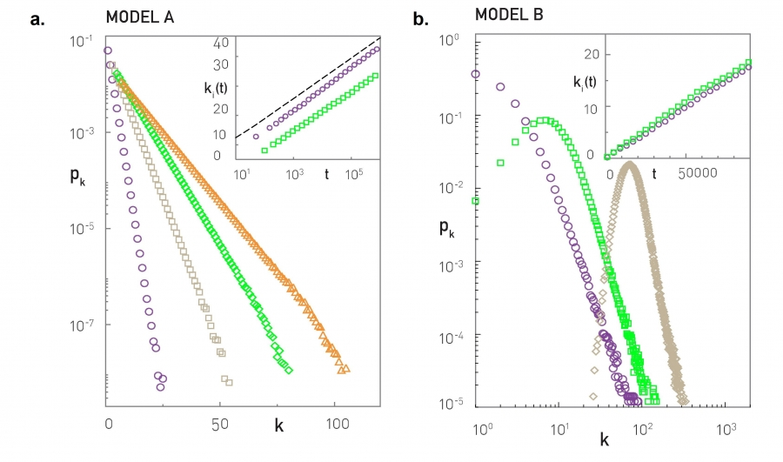
Is it Growth or Preferential Attachment?
Notes:
A = Growth
B=Preferential attachment

Slide 11
Section 3
The Barabási-Albert model

Slide 12
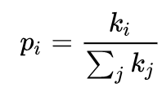
Barabasi-Albert algorithm
Network begins as a connected network of m₀ nodes
For each time window:
One node is added
New node is attached to m ≤ m₀ existing nodes with a probability proportional to the number of links (degrees) existing nodes already possess
Notes:
Probability that the new node is attached to node i

Slide 13
An example
m₀ = 3
m = 2
t=0

Slide 14
An example
m₀ = 3
m = 2
t=1
b
a
c
p_{a}= 1/3
p_{b} = 1/3
p_{c} = 1/3

Slide 15
An example
m₀ = 3
m = 2
t=1
b
a
c
p_{a}= 1/3
p_{b} = 1/3
p_{c} = 1/3

Slide 16
An example
m₀ = 3
m = 2
t=2
b
a
d
c
p_{a}= 3/10
p_{b} = 2/10
p_{c} = 3/10
p_{d}= 2/10

Slide 17
An example
m₀ = 3
m = 2
t=2
b
a
d
c
p_{a}= 3/10
p_{b} = 2/10
p_{c} = 3/10
p_{d}= 2/10

Slide 18
An example
e
m₀ = 3
m = 2
t=3
b
a
d
c
p_{a}= 4/14
p_{b} = 2/14
p_{c} = 3/14
p_{d}= 3/14
p_{e}= 2/14

Slide 19
An example
e
m₀ = 3
m = 2
t=3
b
a
d
c
p_{a}= 4/14
p_{b} = 2/14
p_{c} = 3/14
p_{d}= 3/14
p_{e}= 2/14

Slide 20
An example
e
m₀ = 3
m = 2
t=3
b
a
d
c
p_{a}= 4/14
p_{b} = 2/14
p_{c} = 3/14
p_{d}= 3/14
p_{e}= 2/14
Which node looks like it is becoming a hub?

Slide 21
iClicker Question
What is the probability of linking to a at t=4?
(A) 1/6 | (D) 5/9
(B) 2/3 | (E) 10/19
(C) 5/18
f
e
m₀ = 3
m = 2
t=4
b
a
d
c

Slide 22
Section 4 Linearized Chord Diagram

Slide 23
Question of the Day
Why does the random network model of Erdős and Rényi fail to reproduce the hubs and the power laws observed in many real networks?

Slide 24
Class Activity: Lab02 Workshop
Brainstorm modifications to the basic BA model:
Modification of inputs?
N, m
New inputs?
Different growth model?
Different preferential attachment model?
Different assumptions about starting points?
KEEP GROWTH AND
PREFERENTIAL ATTACHMENT COMPONENTS!
Notes:
Take 5 minutes to jot down some initial ideas
Spend 15 minutes in groups of 4-5 discussing your ideas, critiquing if necessary (does it fail to keep growth and attachment)
Spend 10-15 minutes sharing with class
Spend 10-15 minutes coming up with an algorithm that you can use for Lab02

Slide 25
10 minute Break: Be Back by 6:??
Next up: Bianconi-Barabasi &
Starting to implement Lab02 &
Grad Student Check-in

Slide 26
Reflecting Back on Real Networks
WWW
By 2000, Google (a latecomer) became the WWW’s largest hub
By 2011, Facebook (an extremely latecomer) became the WWW’s largest hub
Based on these facts, how does the BA model fall short of reality?
Notes:
https://moz.com/top500

Slide 27
Introducing Fitness
An intrinsic property that attracts links
Addictiveness/usefulness of a website
A charismatic person
Companies that engender strong loyalty
Other examples?

Slide 28
Fitness is Perceived by the Network
Fitness is not based on any individual node, but on the collective perception of a node’s importance relative to other nodes
www.nau.edu may be very important to nodes in the www.nau.edu domain, but not to most other web pages
A person may be very important in their social circle, but not to the larger social network

Slide 29
Fitness Dictates Preferential Attachment
http://networksciencebook.com/chapter/6#bianconi-model
Notes:
Show Video

Slide 30
Notes:
Alpha is the level of preferential attachment

Slide 31
Bianconi-Barabasi Model
Initial: Starts the same as BA
Growth: At each interval, a node j with random fitness η_{j} is added with m links.
Attachment: Nodes are selected for attachment endpoints based on:
η_{i} k_{i}
Π_{i} =
η_{j} k_{j}
j
Notes:
What does ki mean, what does nj mean
N=eta

Slide 32
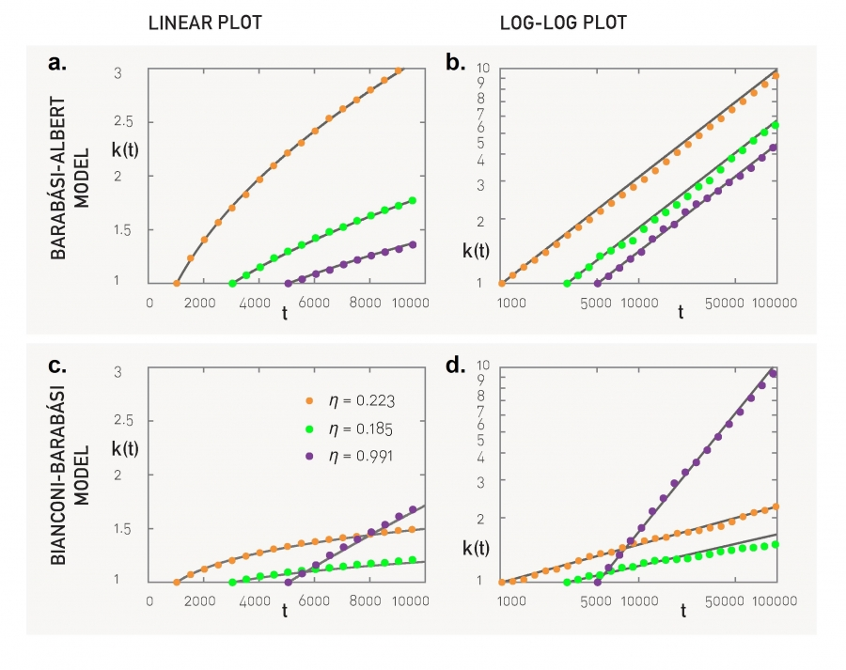
Degree Growth

Slide 33
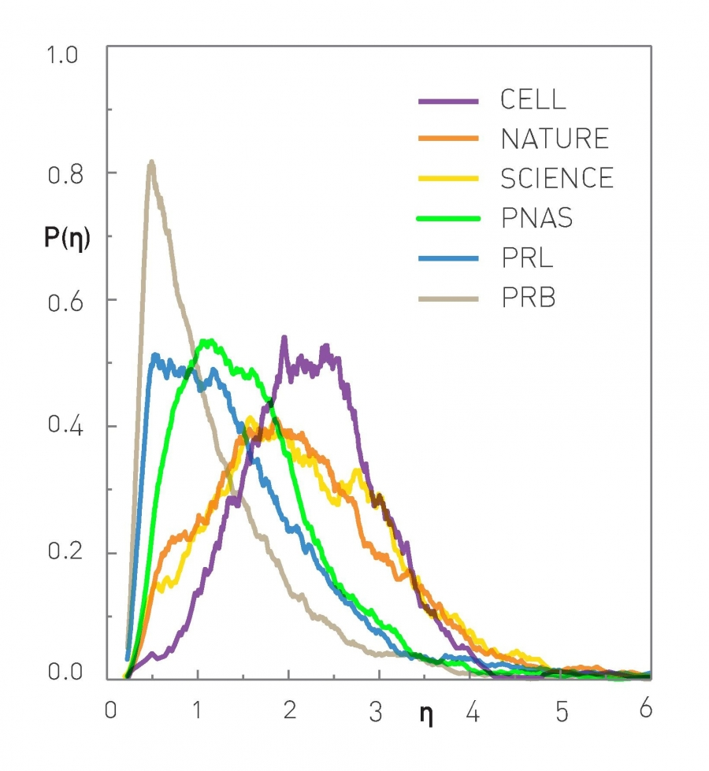
Fitness Distributions in Real Networks

Slide 34
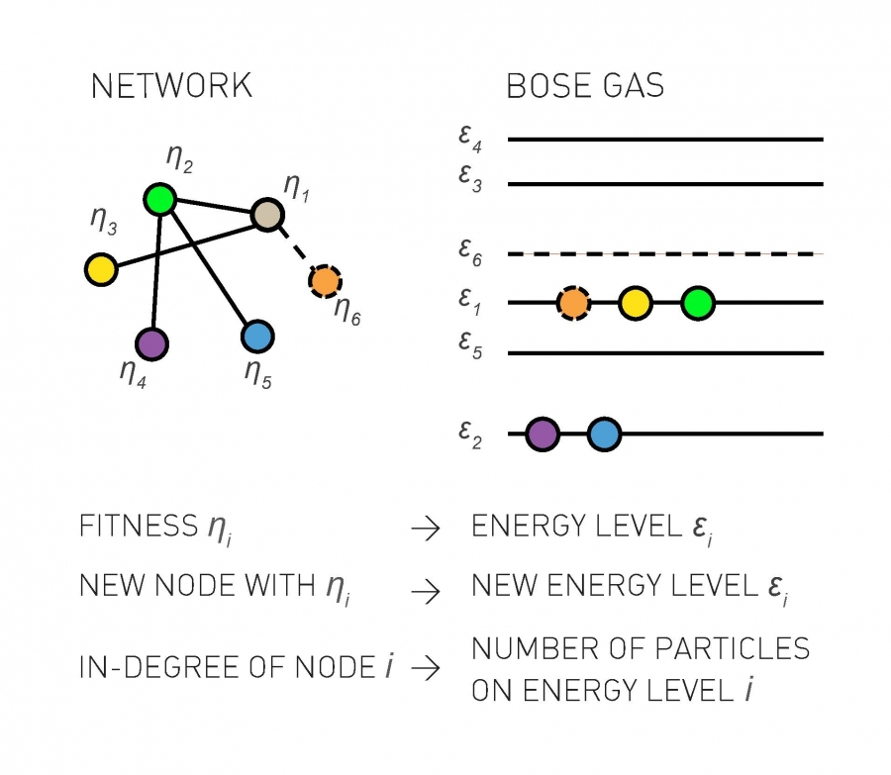
How does topology depend on p()?

Slide 35
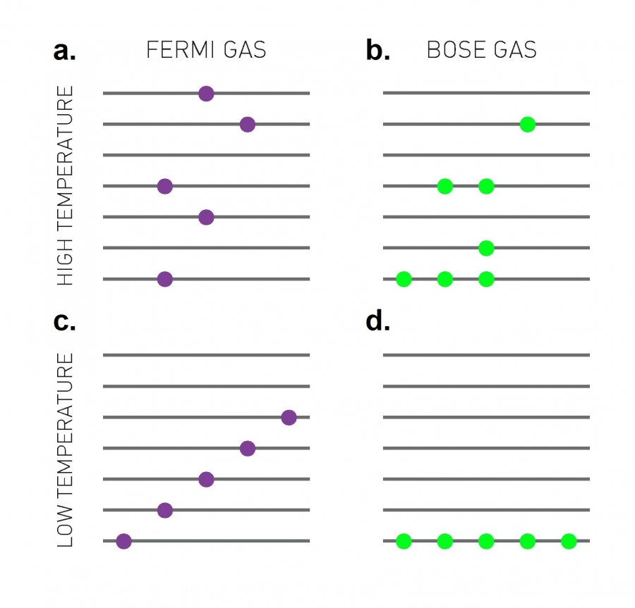
Bose and Bianconi-Barbasi
Bose-Einstein
Condensate
(node(s) with highest fitness take all)

Slide 36
Bose-Einstein Condensation
Show video 6.2
http://networksciencebook.com/chapter/6#bose-einstein

Slide 37
Inducing Bose-Einstein Condensation
Fitness distribution that induces Bose-Einstein Condensation is:
ρ(η)=(1−ζ)(1−η)^{ζ}
Where ζ can be adjusted to induce the condensation effect.
When ρ(η) follows a uniform distribution, a scale-free network emerges….
Notes:
Weird s is zeta

Slide 38
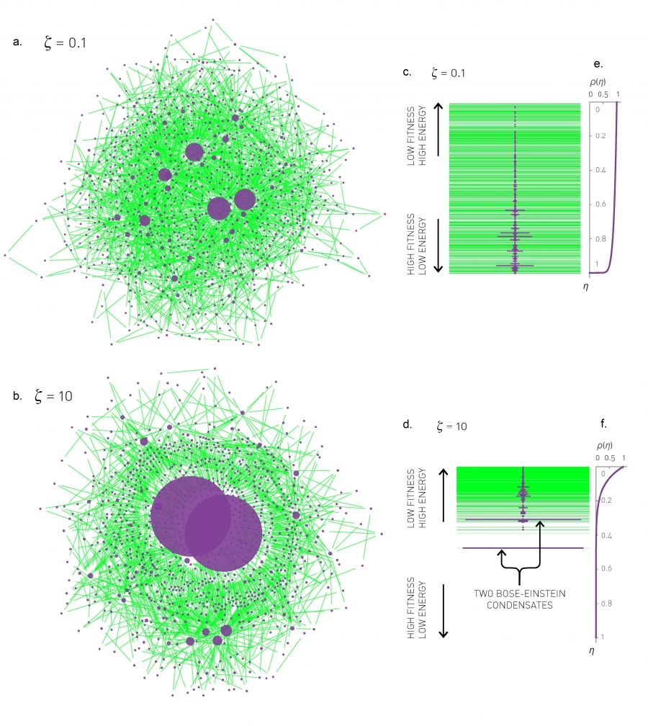
Example

Slide 39
Example

Slide 40
Example

Slide 41
Question of the Day
What does Bose-Einstein condensation mean in a network?

Slide 42
Bianconi-Barabasi in NetworkX
How would you implement it?

Slide 43
Lab02 Walkthrough & Workshop Time
Grad students, if you could come to the front so we could chat about progress, that would be great.

